Slide 1



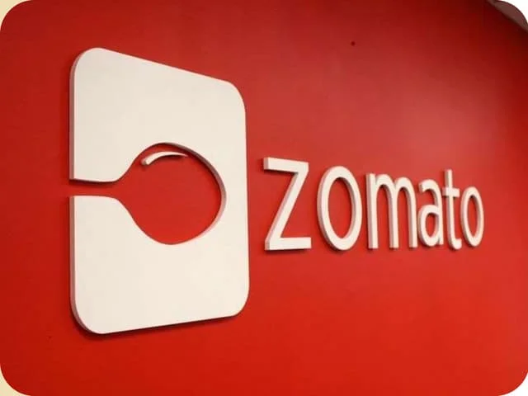



Simple SQL & Python Project
By: Shagun Vashisth

Slide 2
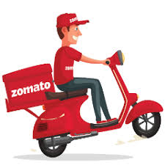
Our team
Shagun Vashisth
Akash
Krish

Slide 3

Project Objectives
• Understand customer ordering behavior
• Identify top-performing restaurants
• Analyze food demand trends
• Study user demographics impact on orders
• Support data-driven business decisions

Slide 4

Problem Statment
• Restaurants generate large volumes of data but lack clear insights.
Key challenges
• Identifying popular food items
• Understanding customer preferences
• Analyzing sales performance
• Segmenting users based on behavior

Slide 5
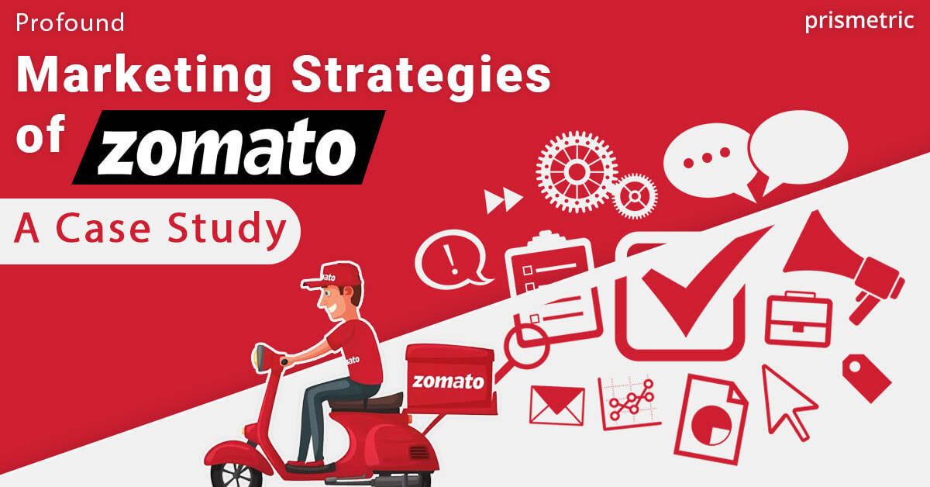

Slide 6
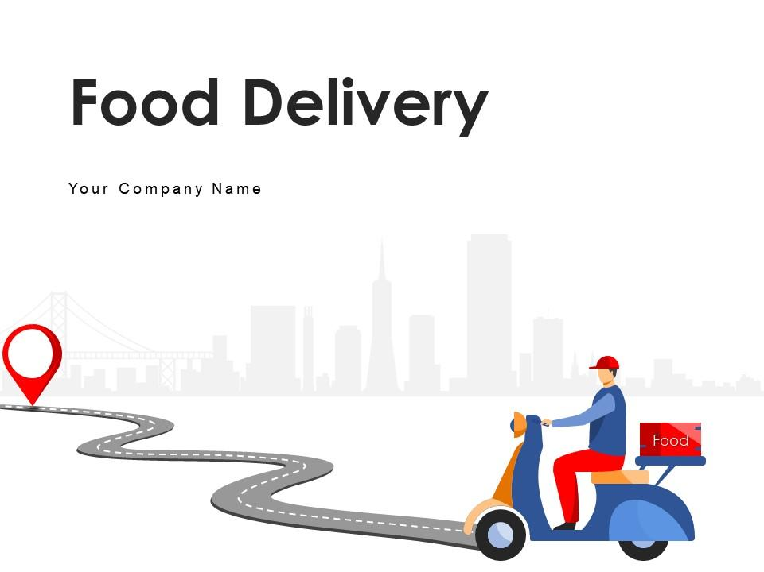
Data Catalog (Datasets Use)
Restaurant
Food
User
Orders
Menu

Slide 7
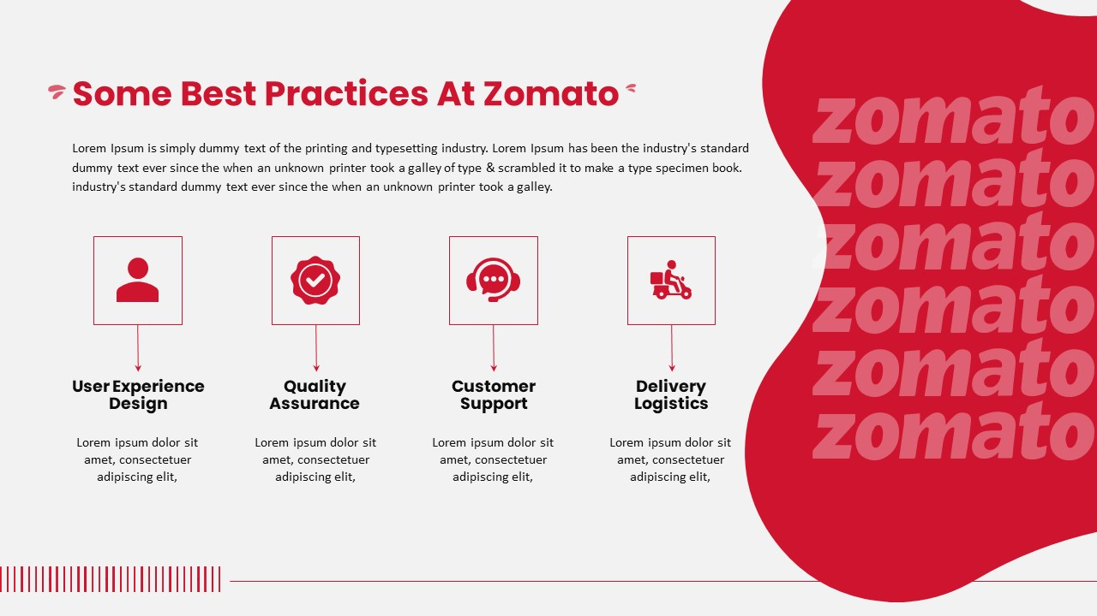
Project Workflow
• Data collection (CSV files)
• Data cleaning & preprocessing
• Data merging & transformation
Exploratory data analysis

Slide 8

Friday
24.2%
Wednesday
20.1%
Thrusday
Order Distribution
by day of Week
19.9%
Tuesday
18.3%
Monday
17.0%
Saturday
0.5%

Slide 9
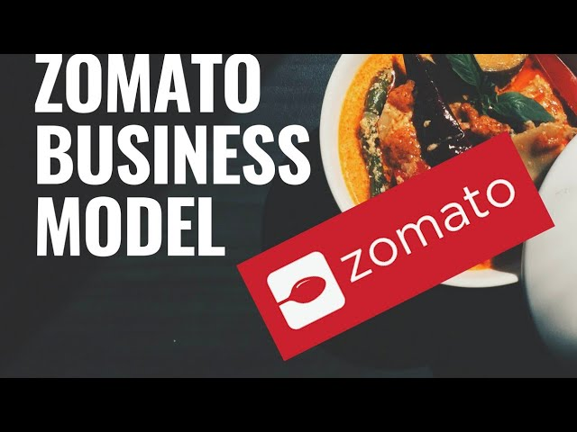
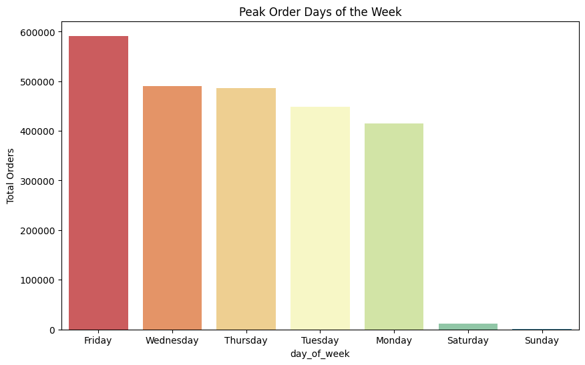
Peak Order days of week

Slide 10
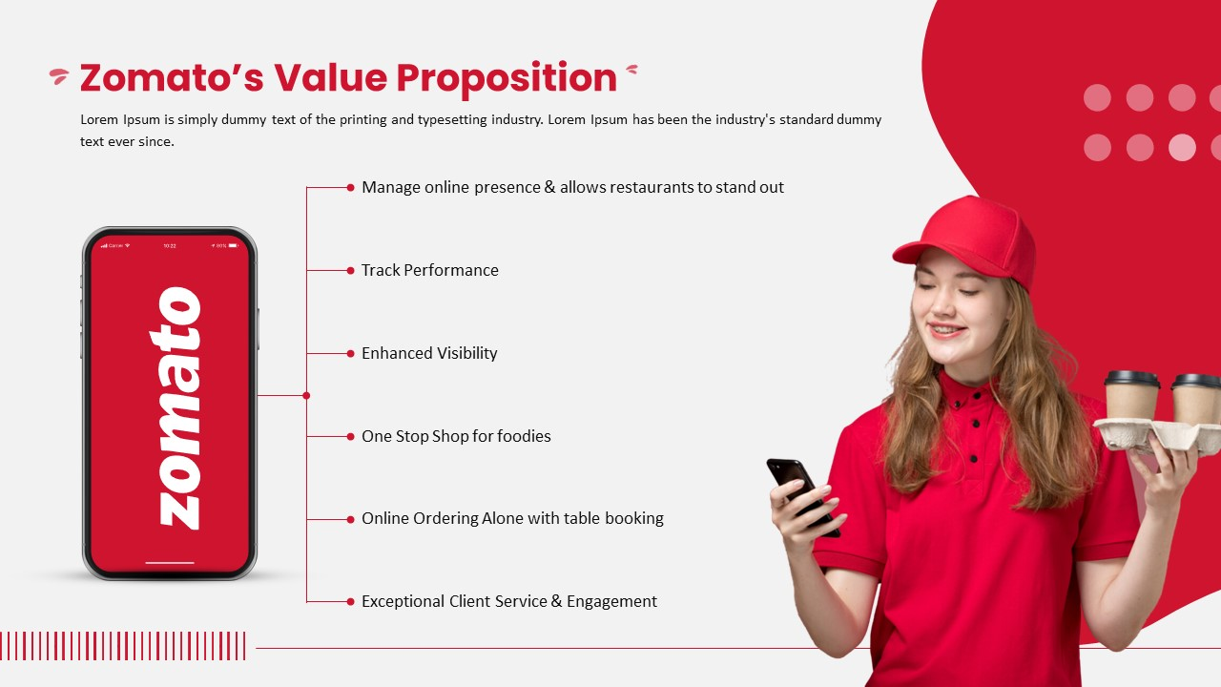
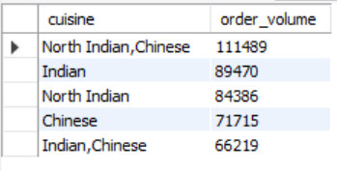
5 Popular Cuisine by order volum

Slide 11
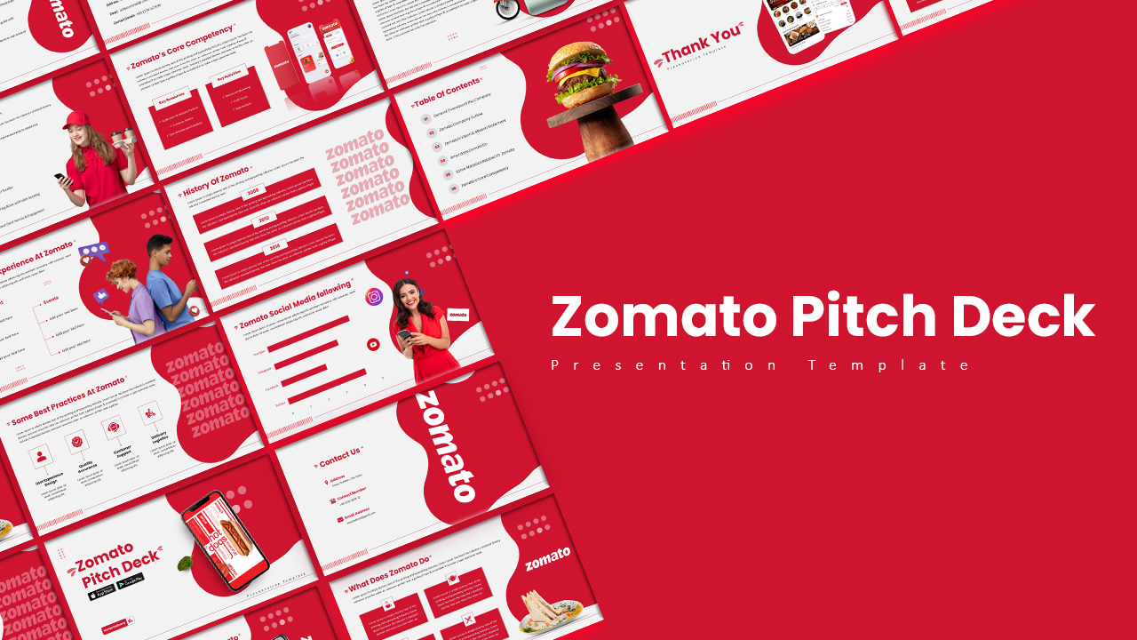
Conclusion
• Data analysis helps improve decision-making
• Businesses can optimize menus and pricing
• Targeted marketing becomes easier
• Project demonstrates real-world data analytics

Slide 12

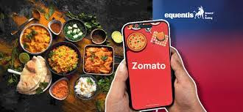
T
Thank You

